Slide 1

Cyber Security
Syllabus for B. Tech. IV Year I semester
Computer Science and Engineering
(Mandatory Course)
Dr. T. Venkat Narayana Rao, Professor
Dept. of CSE, SNIST

Slide 2
Course Objectives
To familiarize with network security, network security threats, security services, and countermeasures.
To be aware of computer security and Internet security.
To study the defensive techniques against these attacks.
To familiarize with cyber forensics.
To be aware of cyber crime related to mobile and laptop etc.
To acquire knowledge relating to Cyberspace laws and Cyber crimes.
To understand ethical laws of computer for different countries, Offences under the Cyberspace and Internet in India.

Slide 3
Course Outcomes At the end of this course the student will be able to
1. Understand cyber-attacks, types of cybercrimes.
2. Realize the importance of cyber security and various forms of cyber attacks and countermeasures.
3. Get familiarity of cyber forensics.
4. Get familiar with obscenity and pornography in cyber space and understand the violation of Right of privacy on Internet.
5. Appraise Cyber laws and also how to protect them self and ultimately the entire Internet community from such attacks.
6. Elucidate the various chapters of the IT Act 2008, power of Central and State Government to make rules under IT Act 2008.
6- The engineer and society
8- Ethics
PO | 1 | 2 | 3 | 4 | 5 | 6- | 7 | 8 | 9 | 10 | 11 | 12
Level |  |  |  |  |  | M |  | M

Slide 4
Contents
UNIT-I: Introduction to cyber Security
UNIT-II: Cyber Forensics
UNIT-III: Cybercrime: Mobile and Wireless Devices
UNIT-IV: Cyber Security: Organizational Implications
UNIT-V: Privacy Issues
UNIT-VI: Cyberspace and the Law &Miscellaneous provisions of IT Act., Cybercrime: Examples and Mini-Cases
TEXT BOOKS:
1. Nina Godbole and Sunit Belpure, Cyber Security Understanding Cyber Crimes, Computer Forensics and Legal Perspectives, Wiley
2. B. B. Gupta, D. P. Agrawal, Haoxiang Wang, Computer and Cyber Security: Principles, Algorithm, Applications, and Perspectives, CRC Press, ISBN 9780815371335, 2018.

Slide 5
Unit I: Introduction to cyber Security
Introduction to Cyber Security- Basic Cyber Security Concepts
Layers of security
Vulnerability, threat
Harmful acts
Motive of attackers
Active attacks, passive attacks, Software attacks, hardware attacks
Spectrum of attacks
Taxonomy of various attacks, IP spoofing
Methods of defense
Security Models, risk management
Cyber Threats-Cyber Warfare, Cyber Crime, Cyber terrorism, Cyber Espionage, etc.,

Slide 6
Introduction to Cyber Security- Basic Cyber Security Concepts
Cyber security is the most concerned matter as cyber threats and attacks are overgrowing.
Attackers are now using more sophisticated techniques to target the systems.
Individuals, small-scale businesses or large organization, are all being impacted.
So, all these firms whether IT or non-IT firms have understood the importance of Cyber Security and focusing on adopting all possible measures to deal with cyber threats.

Slide 7
What is Cyber-security?
Cyber security is the practice of defending computers, servers, mobile devices, electronic systems, networks, and data from malicious attacks. It's also known as information technology security or electronic information security.

Slide 8
What is cyber security?
"Cyber security is primarily about people, processes, and technologies working together to encompass the full range of threat reduction, vulnerability reduction, deterrence, international engagement, incident response, resiliency, and recovery policies and activities, including computer network operations, information assurance, law enforcement, etc."

Slide 9
Other Definitions of Cyber Security
Cyber security is the body of technologies, processes, and practices designed to protect networks, computers, programs and data from attack, damage or unauthorized access.
• The term cyber security refers to techniques and practices designed to protect digital data- stored, transmitted or used on an information system.
OR
Cyber security is the protection of Internet-connected systems, including hardware, software, and data from cyber attacks.
It is made up of two words one is cyber and other is security.
• Cyber is related to the technology which contains systems, network and programs or data.
• Whereas security related to the protection which includes systems security, network security and application and information security.

Slide 10
Why is cyber security important?
Listed below are the reasons why cyber security is so important in what’s become a predominant digital world:
• Cyber attacks can be extremely expensive for businesses to endure.
• In addition to financial damage suffered by the business, a data breach can also inflict untold reputational damage.
• Cyber-attacks these days are becoming progressively destructive. Cybercriminals are using more sophisticated ways to initiate cyber attacks.
• Regulations such as GDPR(General Data Protection Regulation) are forcing organizations into taking better care of the personal data they hold.

Slide 11
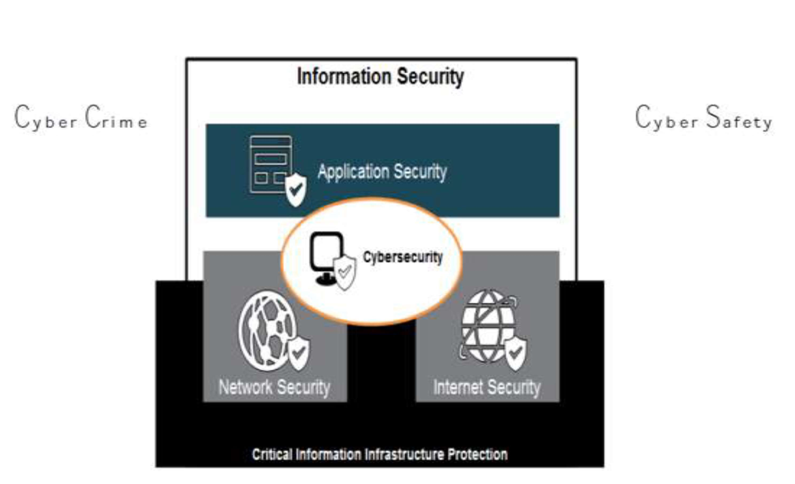
Cybersecurity and Other Security Domains

Slide 12
Other Security domains and Cybersecurity
The term applies in a variety of contexts, from business to mobile computing, and can be divided into a few common categories.
Network security is the practice of securing a computer network from intruders, whether targeted attackers or opportunistic malware.
Application security focuses on keeping software and devices free of threats. A compromised application could provide access to the data its designed to protect. Successful security begins in the design stage, well before a program or device is deployed.
Information security protects the integrity and privacy of data, both in storage and in transit.

Slide 13

Cyber security Fundamentals – Confidentiality, Integrity, Availability (CIA)
Confidentiality - preventing the disclosure of data to unauthorized parties.
Also keep the identity of authorized parties involved in sharing and holding data private and anonymous.
Often confidentiality is compromised by cracking poorly encrypted data, Man-in-the-middle (MITM) attacks, disclosing sensitive data.
Standard measures to establish confidentiality include:
Data encryption
Two-factor authentication
Biometric verification
Security tokens

Slide 14
Integrity
Integrity refers to protecting information from being modified by unauthorized parties.
Standard measures to guarantee integrity include:
Cryptographic checksums
Using file permissions
Data backups
Availability
Availability is making sure that authorized parties are able to access the information when needed.
Standard measures to guarantee availability include:
Backing up data to external drives
Implementing firewalls
Having backup power supplies
Data redundancy

Slide 15
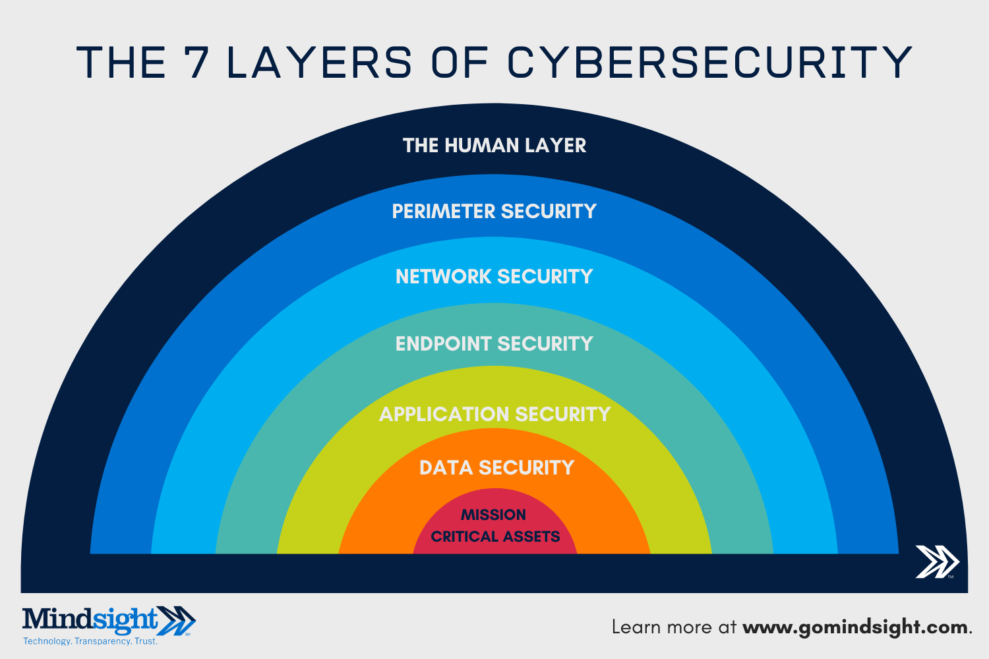

Slide 16
The 7 layers of cyber security should center on the mission critical assets you are seeking to protect.
1: Mission Critical Assets – This is the data you need to protect
2: Data Security – Data security controls protect the storage and transfer of data.
3: Application Security – Applications security controls protect access to an application, an application’s access to your mission critical assets, and the internal security of the application.
4: Endpoint Security – Endpoint security controls protect the connection between devices and the network.
5: Network Security – Network security controls protect an organization’s network and prevent unauthorized access of the network.
6: Perimeter Security – Perimeter security controls include both the physical and digital security methodologies that protect the business overall.
7: The Human Layer – Humans are the weakest link in any cyber security posture. Human security controls include phishing simulations and access management controls that protect mission critical assets from a wide variety of human threats, including cyber criminals, malicious insiders, and negligent users.

Slide 17
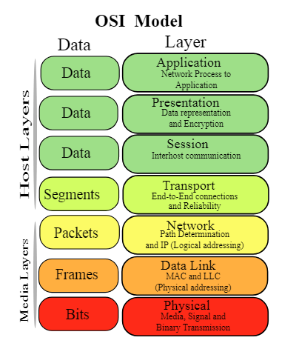
Older Model of Cyber Security (CS)
CS today goes far beyond a networking-only approach. Today, CS traverses far beyond the network realm to the endpoint, perimeter, and the humans on the other side.

Slide 18
Vulnerability, threat, Harmful acts
No system is immune to attacks –
Any company that manages, transmits, stores, or otherwise handles data has to institute and enforce mechanisms to monitor their cyber environment, identify vulnerabilities, and close up security gaps as quickly as possible.
A vulnerability is a weakness or lacuna in a policy, procedure, protocol, hardware or software within an organization that has the potential to cause it damage or loss. A vulnerability is a weakness that makes a threat possible.
Before identifying specific dangers to modern data systems, it is crucial to understand the distinction between cyber threats and vulnerabilities.

Slide 19
A Threat is a possible security violation that might exploit the vulnerability of a system or asset.
Attack is an deliberate unauthorized action on a system or asset. Attack can be classified as active and passive attack
Cyber-attacks include threats like computer viruses, data breaches, and Denial of Service (DoS) attacks.

Slide 20
Vulnerability, threat, Harmful acts (Contd.)
Cyber threats are security incidents or circumstances with the potential to have a negative outcome for your network or other data management systems.
(Or) Possibility of a malicious attempt to damage or disrupt a computer network or system.
Examples of common types of security threats include
phishing attacks that result in the installation of malware that infects your data,
failure of a staff member to follow data protection protocols that cause a data breach, or even a
tornado that takes down your company’s data headquarters, disrupting access.

Slide 21
Vulnerabilities
Gaps or weaknesses in a system that make threats possible and tempt threat actors to exploit them.
Types of vulnerabilities in network security include (but are not limited to)
SQL injections,
server misconfigurations,
cross-site scripting, and
transmitting sensitive data in a non- encrypted plain text format.
Dos [denial of service]
Corrupted (Loss of integrity)
• Leaky (Loss of confidentiality)
• Unavailable or very slow (Loss of availability)
When threat probability is multiplied by the potential loss that may result, cyber security experts refer to this as a risk.

Slide 22
SECURITY VULNERABILITIES, THREATS AND ATTACKS
Categories of vulnerabilities
• Corrupted (Loss of integrity)
• Leaky (Loss of confidentiality)
• Unavailable or very slow (Loss of availability)
Threats represent potential security harm to an asset when vulnerabilities are exploited
Attacks are threats that have been carried out
• Passive – Make use of information from the system without affecting system resources
• Active – Alter system resources or affect operation
• Insider – Initiated by an entity inside the organization
• Outsider – Initiated from outside the perimeter

Slide 23
Motive of Attackers and their actions
i) inadvertent actions (generally by insiders) that are taken without malicious or harmful intent
ii) deliberate actions (by insiders or outsiders) that are taken intentionally and are meant to do harm; and
iii) inaction (generally by insiders), such as a failure to act in a given situation, either because of a lack of appropriate skills, knowledge, guidance, or availability of the correct person to take action

Slide 24
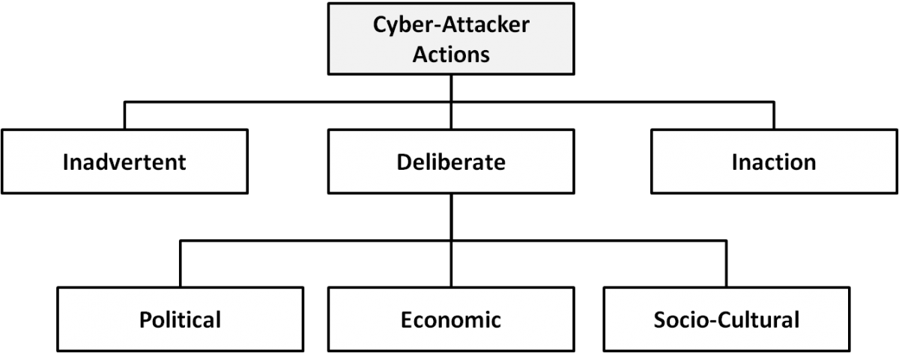
Types of cyber-attacker actions and their motivations when deliberate

Slide 25
Deliberate Attack Motivation
Political motivations: examples include destroying, disrupting, or taking control of targets; espionage; and making political statements, protests, or retaliatory actions.
Economic motivations: examples include theft of intellectual property or other economically valuable assets (e.g., funds, credit card information); fraud; industrial espionage and sabotage; and blackmail.
Socio-cultural motivations: examples include attacks with philosophical, theological, political, and even humanitarian goals (Gradido et al., 2012). Socio-cultural motivations also include fun, curiosity, and a desire for publicity or ego gratification.

Slide 26
Active attacks, passive attacks, Software attacks, hardware attacks
An active attack is a network exploit in which a hacker attempts to make changes to data on the target or data en route to the target.
Types of Active attacks:
Masquerade: in this attack, the intruder pretends to be a particular user of a system to gain access or to gain greater privileges than they are authorized for. A masquerade may be attempted through the use of stolen login IDs and passwords, through finding security gaps in programs or through bypassing the authentication mechanism.
Session replay: In this type of attack, a hacker steals an authorized user’s log in information by stealing the session ID. The intruder gains access and the ability to do anything the authorized user can do on the website.
Message modification: In this attack, an intruder alters packet header addresses to direct a message to a different destination or modify the data on a target machine.
In a denial of service (DoS) attack, users are deprived of access to a network or web resource. This is generally accomplished by overwhelming the target with more traffic than it can handle.
In a distributed denial-of-service (DDoS) exploit, large numbers of compromised systems (sometimes called a botnet or zombie army) attack a single target.

Slide 27
Active attacks, Passive attacks, Software attacks, hardware attacks
Passive attacks are relatively scarce from a classification perspective, but can be carried out with relative ease, particularly if the traffic is not encrypted.
Types of Active attacks:
Eavesdropping (tapping): the attacker simply listens to messages exchanged by two entities. For the attack to be useful, the traffic must not be encrypted. Any unencrypted information, such as a password sent in response to an HTTP request, may be retrieved by the attacker.
Traffic analysis: the attacker looks at the metadata transmitted in traffic in order to and the participating entities, e.g. the form of deduce information relating to the exchange the exchanged traffic (rate, duration, etc.). In the cases where encrypted data are used, traffic analysis can also lead to attacks by cryptanalysis, whereby the attacker may obtain information or succeed in unencrypting the traffic.

Slide 28
Active attacks, Passive attacks, Software attacks, hardware attacks
Malicious code (sometimes called malware) is a type of software designed to take over or damage a computer user's operating system, without the user's knowledge or approval.
It can be very difficult to remove and very damaging.
Common malware examples are
Virus
Worm
Trojan horse
Logic Bomb

Slide 29
Virus A virus is a program that attempts to damage a computer system and replicate itself to other computer systems. A virus:
• Requires a host to replicate and usually attaches itself to a host file or a hard drive sector.
• Replicates each time the host is used.
• Often focuses on destruction or corruption of data.
• Usually attaches to files with execution capabilities such as .doc, .exe, and .bat extensions.
• Often distributes via e-mail. Many viruses can e-mail themselves to everyone in your address book.
• Examples: Stoned, Michelangelo, Melissa, I Love You.
Worm A worm is a self-replicating program that can be designed to do any number of things, such as delete files or send documents via e-mail. A worm can negatively impact network traffic just in the process of replicating itself. A worm:
• Can install a backdoor in the infected computer.
• Is usually introduced into the system through a vulnerability.
• Infects one system and spreads to other systems on the network.
• Example: Code Red.

Slide 30
Trojan horse A Trojan horse is a malicious program that is disguised as legitimate software. Discretionary environments are often more vulnerable and susceptible to Trojan horse attacks because security is user focused and user directed. Thus the compromise of a user account could lead to the compromise of the entire environment. A Trojan horse:
• Cannot replicate itself.
• Often contains spying functions (such as a packet sniffer) or backdoor functions that allow a computer to be remotely controlled from the network.
• Often is hidden in useful software such as screen savers or games.
• Example: Back Orifice, Net Bus, Whack-a-Mole.
Logic Bomb A Logic Bomb is malware that lies dormant until triggered. A logic bomb is a specific example of an asynchronous attack.
• A trigger activity may be a specific date and time, the launching of a specific program, or the processing of a specific type of activity.
• Logic bombs do not self-replicate.

Slide 31
Active attacks, Passive attacks, Software attacks, Hardware attacks
Common hardware attacks include:
• Manufacturing backdoors, for malware or other penetrative purposes; backdoors aren’t limited to software and hardware, but they also affect embedded radio- frequency identification (RFID) chips and memory
• Eavesdropping by gaining access to protected memory without opening other hardware
• Inducing faults, causing the interruption of normal behavior
• Hardware modification tampering with invasive operations
• Backdoor creation; the presence of hidden methods for bypassing normal computer authentication systems
• Counterfeiting product assets that can produce extraordinary operations and those made to gain malicious access to systems.

Slide 32
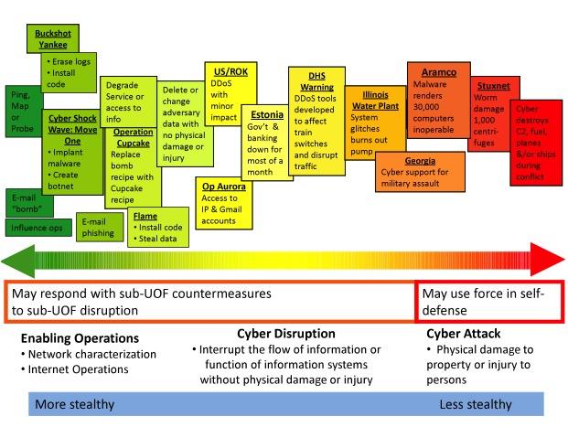
Spectrum of Cyber Attacks

Slide 33
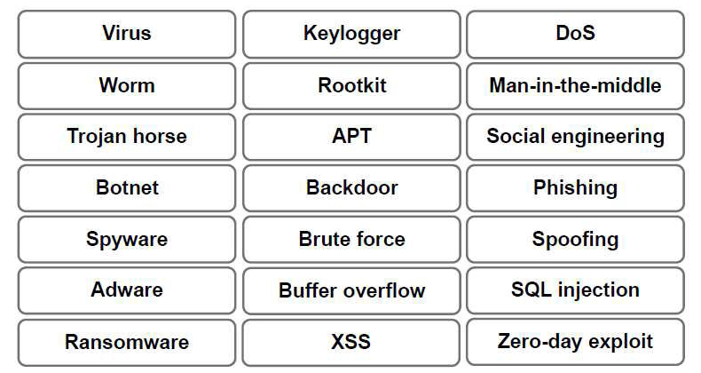
Taxonomy of various attacks - Malware and Attack types

Slide 34
Spoofing
is a situation in which one person or program successfully masquerades as another by falsifying information/data and thereby gaining an illegitimate advantage.
Types of Spoofing
IP Spoof
Web Spoof
E-mail Spoof
Non Technical Spoof

Slide 35
IP Spoofing- Purpose
The creation of IP packets with a forged source. The purpose of it is to conceal the identity of the sender or impersonating another computing system.
Denial-of-service attack
the goal is to flood the victim with overwhelming amounts of traffic. This prevents an internet site or service from functioning efficiently or at all, temporarily or indefinitely.
To defeat networks security
Such as authentication based on IP addresses.
This type of attack is most effective where trust relationships exist between machines.
For example, some corporate networks have internal systems trust each other, a user can login without a username or password as long he is connecting from another machine on the internal network. By spoofing a connection from a trusted machine, an attacker may be able to access the target machine without authenticating.

Slide 36
Defense against IP spoofing
Packet filtering- one defense against IP spoofing
Ingress filtering- blocking of packets from outside the network with a source address inside the network
Egress filtering –blocking outgoing packets from inside the network source address.
Upper Layers
Some upper layer protocols provide their own defense against IP spoofing.
For example, TCP uses sequence numbers negotiated with the remote machine to ensure that the arriving packets are part of an established connection. Since the attacker normally cant see any reply packets, he has to guess the sequence number in order to hijack the connection.

Slide 37
Web Spoofing
It’s a security attack that allows an adversary to observe and modify all web pages sent to the victim’s machine and observe all information entered into forms by the victim.
The attack is initiated when a victim visits a malicious web page, or receives a malicious email message.
The attack is implemented using JavaScript and Web serves plug-ins.
Dangers of Web Spoofing
After your browser has been fooled, the spoofed web server can send you fake web pages or prompt you to provide personal information such as login Id, password, or even credit card or bank account numbers.

Slide 38
How to prevent Web Spoofing
Don’t click links in emails instead always copy and paste, or even better manually type the URL in.
When entering personal or sensitive information, verify the URL is as you expect, and the site’s SSL certificate matches that URL[padlock button] .
Understand why you’re providing the information-does it make sense? Does the site need to know your SSN?

Slide 39
Email Spoof
E-mail spoofing is the forgery of an e-mail header so that the message appears to have originated from someone or somewhere other than the actual source.

Slide 40
Email Spoof Protection
Double check the email you are replying to, make sure that the letters are what they truly seem. For example, l(lower case L) is not the same as I(upper case i).
Look at the IP information of the email header. If an email originated from inside your network, the sender should have very similar IP address.

Slide 41
Non-Technical Spoofing
These non-computer based techniques are commonly referred to as social engineering. With social engineering, an attacker tries to convince someone that he is someone else.
This can be as simple as the attacker calling someone on the phone saying that he is a certain person.

Slide 42
Example of Non-Technical Spoofing
An attacker calls the help desk to request a new account to be set up. The attacker pretends to be a new employee.
A “technician” walks into a building saying that he has been called to fix a broken computer. What business does not have a broken computer?

Slide 43
Why does Non-Technical Spoof Works.
The main reason is that it exploits attributes of human behavior: trust is good and people love to talk. Most people assume that if someone is nice and pleasant, he must be honest. If an attacker can sound sincere and listen, you would be amazed at what people will tell him.

Slide 44
Non-Technical Spoof Protection
Educate your users
The help desk
Receptionist
Administrators
Have proper policies:
Password policy
Security policy

Slide 45
Defence Strategies
Prevention
Detection
Recovery Forensics

Slide 46
Examples of Preventive Strategies
Code Auditing and Testing (against software flaws)
Blackbox Whitebox
Access Control (against unauthorized access) Authentication
Authorization
Encryption (against eavesdropping)

Slide 47
Examples of Detection
Integrity checks on messages, files
Simple CRC-type checksums not effective for security applications
Use of the Message Authentication (MAC),
Intrusion detection systems based on
Anomaly detection Signature detection

Slide 48
Commonly used terms in security parlance
Security Policy is the set of rules and practices that regulate how an organization manages and protects its computing and communication resources from unauthorized use or misuse.
A security mechanism is a technique or device used to implement a security policy.

Slide 49
Commonly used terms in security parlance (contd.)
Access Control is the process of preventing unauthorized access to a computing or communication resource
Authorization
involves
granting a specific
entity or process the permission to access
restricted operation
data or
perform a restricted

Slide 50
Commonly used terms in security parlance (contd.)
Entity Authentication is the process of verifying that the entity being communicated with is indeed the entity it claims to be.
Message Authentication is the process of verifying the source or origin of the message.

Slide 51
What does secure communications imply?
Confidentiality is the protection of data from disclosure to an unauthorized party or process
Integrity is the assurance that data has not been modified, tampered with or made inconsistent in any way

Slide 52
Secure communications (contd.)
Non-repudiation offers a guarantee against repudiation or denial by a party of the fact that it created or sent a particular message

Slide 53
Security Practice Principle 1
Security is as much (or more) a human problem rather than a technological problem and must be addressed at different levels.
Besides processes and technology, security is also a people problem and should involve a security team headed by a CISO (chief information security officer) system administrators and all members of an organization through awareness programs

Slide 54
Security Practice Principle 2
Security should be factored in at inception, not as an afterthought
Security should be factored in early on during the design phase of a new product and then carried forward right through implementation and testing.

Slide 55

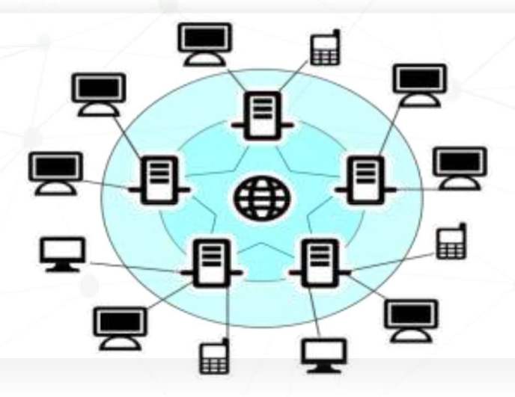


Cyber Space
"Cyberspace" is the term used to describe the electronic medium of digital networks used to store, modify and communicate information. It includes the Internet but also other information systems that support businesses, infrastructure and services.^{[5]}

Slide 56
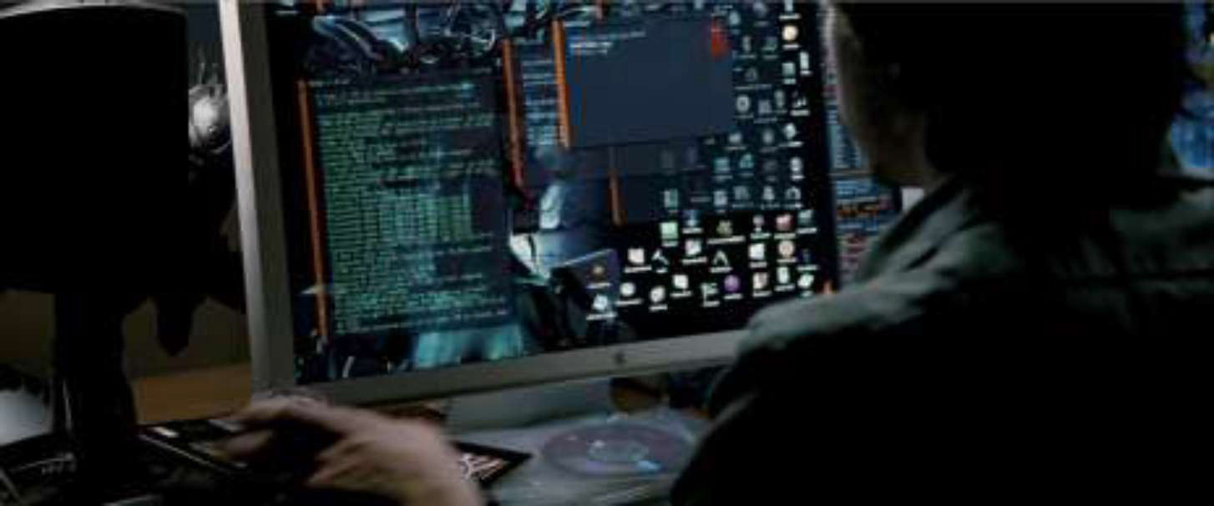
Define Cyber Threats
All those activities damaging or stealing data or destroying digital life.^{[1]}
Cyber attacks are one of the biggest threats on our digital life.
People are less aware about these cyber threats.
Cyber attacks mainly focus on taking unauthorized access, damage destroying or stealing sensitive information from computer infrastructure like servers or personal computers or any other mobile devices.
Virus, DoS, Phishing, ect.

Slide 57
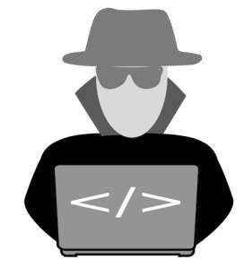
Threats
Nations cyber warfare program Terrorist Groups
Spies Hacktivists
- manage political activity on digital media, to spread political agendas
insiders
Hackers - for challenging or seeking money Natural disasters
Mistakes from authorized users
- wrong system configurations and setups

Slide 58

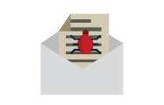
Tools !
Malwares
Spywares Phishing DoS / DDos
Ransomware Trojans
Zero - Day exploits
Intellectual property theft Money demanding
Data manipulations
Man-in-the-middle attack - MITM
Roge softwares / Pirated softwar

Slide 59
Cyber Warfare
Cyber warfare is the action that taken by national / international organizations or groups to attack and damage targeted computers or digital infrastructure by using internet.
Examples: DDos attack, network spoofing, computer virus, etc.
Cyber warfare can present multiple threats for targeted nations or organizations or even individual persons. a long term program !
Most basic cyber attacks are using traditional warfare technology. Like network spoofing (in this attack, the attacker successfully still identity and use it for his own advantages ) or virus(warm or trojan horse).

Slide 60

Cyber Warfare
Targets can be soft or hard !
Hard target - gain access to physical devices and mislead it or misuse it.
Example: in 2007, Israel Spoofed Syria's Air Defense System[3]. Soft target -Unauthorised access to computer system and retrieving secret informations.
Example: Cyber Espionage and digital propaganda.
One of the famous and very popular examples for modern advanced cyber warfare is, PRISM project by NSA - National Security Agency - USA.

Slide 61
Type of Cyber Warfare
Espionage
DoS or DDoS - Distributed + Denial of service attack
Propaganda - mostly for politics - Damage is psychological. Social media, fake news or memes.
Economic Disruption - targeting big company or share bazar markets. - WannaCry ransomware attack 2017.
Surprise cyber attack - Website defacement, Leaking sensitive information

Slide 62

Motivations !
Military
Civil Hackticism
Income generation Private sector
Non-profit research

Slide 63
Cyber Terrorism
Traditional Terrorism:
- Use of violence to achieve political or ideology.
Digital Terrorism:
-With the use of INTERNET, performing some kind of activity that loss of life, harming a person or organisation in order to achieve traditional terrorism in digital way called Cyber Terrorism.

Slide 64
Impacts
Economical damage and Disruptions
communications Disruptions
Supply Chain for Misleading peoples Physiological damaging
Personal data Spying
Stealing valuable information

Slide 65
What is Espionage ?
Espionage is the process of gathering information that is not publicly available, using humans or already existed somewhere on digital or physical forms. And those information can be used for critical decision making or predicting for personal benefits or the interest of more power.
It's totally different from government surveys or information gathering, because most governments are depending on a certain range of information to develop the country.

Slide 66
Digital equipments, Internet,
IOT,
Fast computers
Cyber Espionage
Spying
Simple to complex form
0
t

Slide 67
Cyber Threats-Cyber Warfare, Cyber Crime, Cyber terrorism, Cyber Espionage
Cyber Threats-Cyber Warfare: Cyber warfare refers to the use of digital attacks -- like computer viruses and hacking -- by one country to disrupt the vital computer systems of another, with the aim of creating damage, death and destruction. Future wars will see hackers using computer code to attack an enemy's infrastructure, fighting alongside troops using conventional weapons like guns and missiles.
Cyber warfare involves the actions by a nation-state or international organization to attack and attempt to damage another nation's computers or information networks through, for example, computer viruses or denial-of-service attacks.
Cyber Crime:
Cybercrime is criminal activity that either targets or uses a computer, a computer network or a networked device. Cybercrime is committed by cybercriminals or hackers who want to make money. Cybercrime is carried out by individuals or organizations.
Some cybercriminals are organized, use advanced techniques and are highly technically skilled. Others are novice hackers.

Slide 68
Cyber Threats-Cyber Warfare, Cyber Crime, Cyber terrorism, Cyber Espionage (contd.)
Cyber Terrorism:
Cyber terrorism is the convergence of cyberspace and terrorism. It refers to unlawful attacks and threats of attacks against computers, networks and the information stored therein when done to intimidate or coerce a government or its people in furtherance of political or social objectives.
Examples are hacking into computer systems, introducing viruses to vulnerable networks, web site defacing, Denial-of-service attacks, or terroristic threats made via electronic communication.
Cyber Espionage:
Cyber spying, or cyber espionage, is the act or practice of obtaining secrets and information without the permission and knowledge of the holder of the information from s
individuals, competitors, rivals, groups, governments and enemies for personal, economic, political or military advantage using methods on the Internet.

